Slide 1

Poverty,inequality and social policies
in Brazil, 1995-2012
Pedro H. G. Ferreira de Souza
Fernando Gaiger Silveira
Sergei Soares

Slide 2
Gini Coefficient, 1995-2012

Slide 3
Extreme poverty
(1.25 US$ PPP/day)
Brazilian MDG goal
reached
in 2007
Source: Pesquisa Nacional por Amostra de Domicílios, 1995-2009
Poverty reduction dates back to the late 1990s but has picked up speed since the mid-2000s as the economic recovery was combined with the fall of income inequality.
In 2011, poverty eradication was announced as the top priority of the newly inaugurated president Dilma Rousseff.

Slide 4
Brazilian exceptionalism?
The 2000s were a good decade for developing economies especially in Latin America, where several countries went through a period of pro-poor growth.
Countries | Annual GDP growth 2002-2009 (% per year) | Change in the Gini index of the household per capita income in the 2000s (%)
Argentina | 3.7 | -15
Brazil | 3.7 | -9
Chile | 4.2 | -6
Colombia | 4.4 | -1
Mexico | 2.8 | -6
Peru | 5.6 | -13
Venezuela | 4.4 | -1
Sources: GDP Growth: United Nations. World Economic Situation and Prospects 2011. Inequality: Socio-Economic Database for Latin America and the Caribbean (CEDLAS and The World Bank). Note that in order to ensure comparability CEDLAS makes a wide range of adjustments to the original data sets. The years used to estimate the Gini coefficient are as follows: Argentina, 2003-2009; Brazil, 2001-2009; Chile, 2000-2009; Colombia, 2001-2004; Mexico, 2000-2008; Peru, 2003-2009; Venezuela, 2000-2006.

Slide 5
Poverty, inequality and the State
(Major public policies)
State interventions impinge directly and indirectly on poverty and inequality in a myriad of ways. Some are very pro-poor and help to reduce inequality (i.e.: Bolsa Família). Others are notoriously regressive: the Brazilian tax code, for instance, relies heavily on indirect consumption taxes which are known to take a greater toll on the poor. Several are either ambiguous or hard to measure (such as the expenditures on the Universal Health System).
The most prominent ones are related to typical areas of intervention of the 20th century Welfare States :
  Education
  Minimum wage
  Social Security and retirement pensions
  Social assistance and cash transfers

Slide 6
Poverty, inequality and the State
(Major public policies)
Selected Government Expenditures (% of GDP)
Expenditures | Share of GDP (%)
Public education | 3.8
Social security and pensions | 11.1
Private sector | 6.8
Civil servants | 4.3
Social assistance | 0.8
Benefício de Prestação Continuada (BPC) | 0.4
Programa Bolsa Família (PBF) | 0.4
Total | 15.7
Total tax revenue | 34.1
Source: Mostafa, J; Souza, PHGF; Vaz, FM. Efeitos econômicos do gasto social. In: Castro, JA; Ferreira, H; Campos, AG; Ribeiro, JAC (Org). Perspectivas da Política Social no Brasil. Brasília: Ipea, 2010. Total tax revenue from Ribeiro, MB. Uma análise da carga tributária bruta e das transferências de assistência e previdência no Brasil no período 1995-2009: evolução, composição e suas relações com a regressividade e a distribuição de renda. In: Castro, JA; Santos, CHM; Ribeiro, JAC. Tributação e eqüidade no Brasil: um registro da reflexão do Ipea no biênio 2008-2009.Brasília: Ipea, 2010.

Slide 7
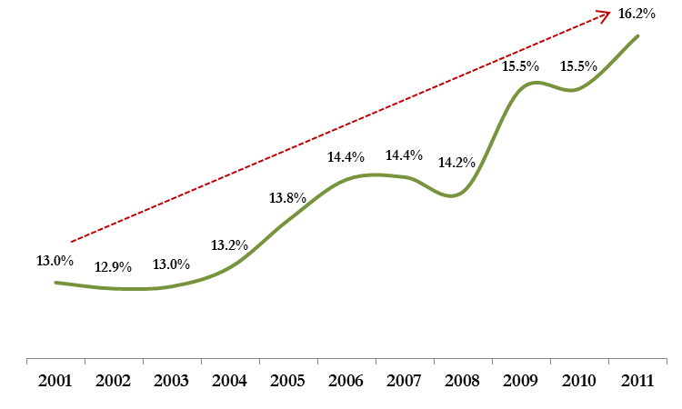
Federal Social Spending as % of GDP
Source: Ipea

Slide 8
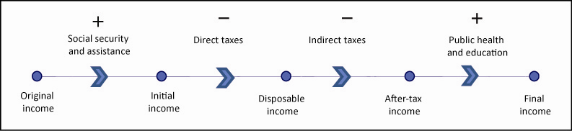
The Stages of Income Redistribution

Slide 9
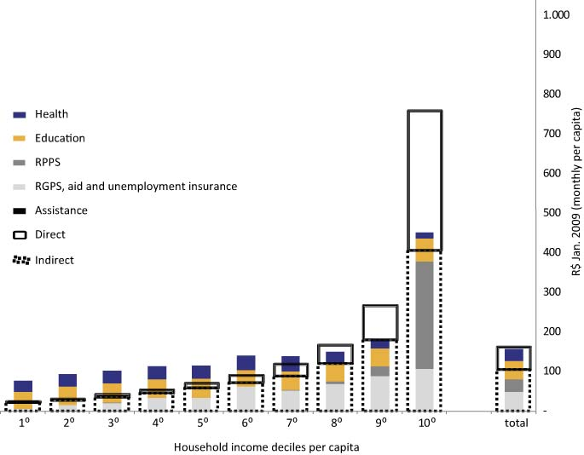
Monthly Household Income Per Capita and Monthly Household Amounts Per Capita of Direct and Indirect Taxes, Social Security and Assistance Benefits and Health and Public Education, Brazil, 2003
￼

Slide 10
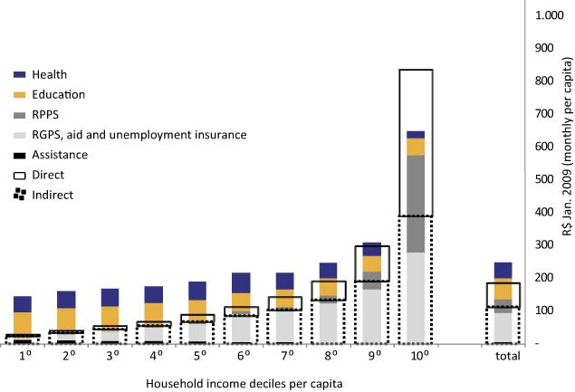
Monthly Household Income Per Capita and Monthly Household Amounts Per Capita of Direct and Indirect Taxes, Social Security and Assistance Benefits and Health and Public Education, Brazil, 2009
￼

Slide 11
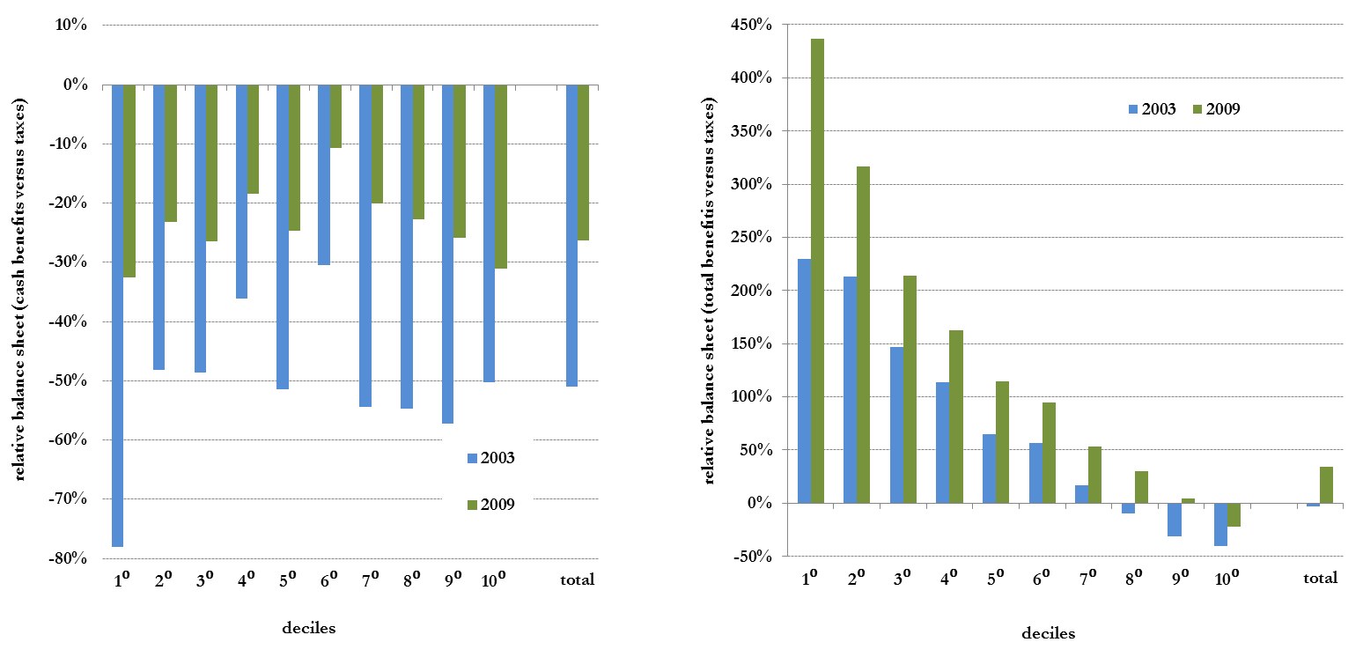
Balance sheet between what one pays in taxes and what one receives in benefits
Cash benefitis X taxes
Total benefitis X taxes
Source: POF-IBGE (Consumer Expenditure Survey)

Slide 12
Taxes
Indirect (VAT and others)
One applies the tax rules, i.e., the nominal rates:
  hypothesis of perfect operation of law;
  calculates the out-of-pocket burden and not how much the government collects
Direct
reported: Income Tax, Social Security Contribution (part of the employees), Real Estate Tax and Motor Vehicle Property Tax
Social Spending
Direct Government Transfers
(monetary transfers)
reported: pensions and other social security benefits, assistencial benefits (like Bolsa Família), unemployment insurance.
In-kind Government Transfers
Education: average public spending by student, according to level and grade
Health: distribution of public spending on health based on the use of public health services.

Slide 13
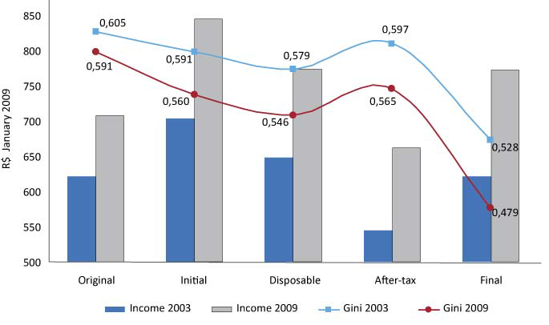
Behaviour of the Gini Index in the Total, Original, Initial, Disposable and Final Income, Brazil (2002–2003 and 2008–2009)

Slide 14
Minimum wage
(ii)
Monthly minimum wage (US$ PPP) – 1985.01/2011.01
∆ 2005-2011:
+10% per year
∆ 1995-2005:
+7% per year
Source: Ipeadata.

Slide 15
Minimum wage
(iii)
According to the PNAD, in 2009 9 million workers (mostly in the formal sector) received the minimum wage as remuneration, which corresponds to roughly 11% of the labour force.
On the other hand, almost 60% of pensioners had benefits equal to the minimum wage – more than 13 million people. These benefits are heavily subsidized by the federal government and profoundly redistributive, though expensive.
Additionally, the social assistance benefit to poor people over 65 or with a disability (BPC) also paid a minimum wage to 1.5 million* people.

Slide 16
Social Security
(i)
Social Security dates back to the late 19th Century industry-specific Funds for Retirement and Pensions which were progressively unified under a framework inspired by the Bismarckian German model. It became fully state-run in the 1960s and only after the 1988 Constitution it became entirely separate from the health care system.
To this day it has at least two main branches – one for private sector workers and one for civil servants. As a mandatory and contributory system that benefits mostly formal workers, it has traditionally left out a considerable proportion of the Brazilian population.
Since the 1988 Constitution, however, it has been expanded considerably – for instance, the so-called “Rural Social Security”, which is almost non-contributory as it encompasses mostly small farmers and poor rural workers, went from 4 million monthly benefits in 1991 to 7 million in 2003, a 75% increase in just 12 years. This development helped in reducing income inequality and poverty in rural areas. More recently, the rapid creation of formal jobs has been another key factor in enlarging the reach of the Social Security.

Slide 17
Social Security
(ii)
The widening coverage coupled with the minimum benefits being tied to the minimum wage have turned the Brazilian Social Security into an useful tool to combat poverty among the elderly.
In 2009, about 90% of the population over 65 received a Social Security benefit and poverty levels were below 1% for this group (vs ~8% among children 15 or younger).
The flipside of this system is that it runs significant deficits annually – about 1.3% of GDP for the Private Sector and 2% for the Civil Servants’ Social Security. This and the general ageing of the population has put the Social Security under scrutiny, with recent reforms trying to limit expenses by tightening the retirement conditions.
The deficits are not a particularly worrisome issue for the Private Sector Social Security, as those can be partially swayed if the recent trend of formalization continues. Also, the benefits paid are generally progressive and very important when it comes to alleviating poverty among the elderly.
On the other hand, the Civil Servants’ Social Security covers just a tiny fraction of the population and its large paychecks actually contribute to increase income inequality. Therefore, those deficits are far more troublesome. It is still too early to assess the impact of the 2003 reform, but preliminary evaluations suggest it may have far-reaching consequences.

Slide 18
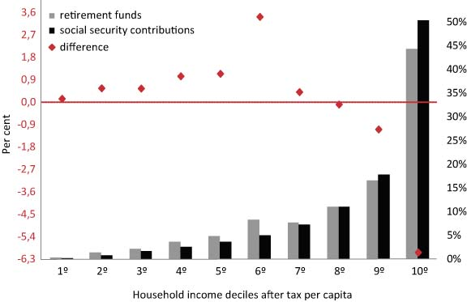
Share of Retirement Pensions (and other pensions) and Social Security Contributions, by Deciles of Household Cash Income Per Capita, Brazil (2002–2003 and 2008–2009)

Slide 19
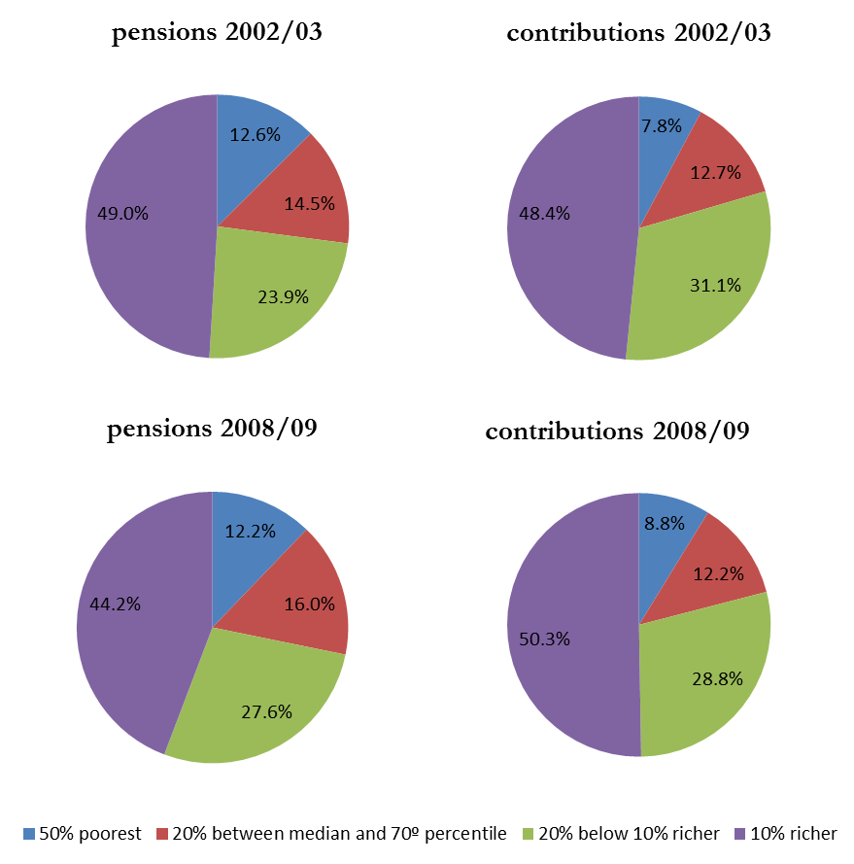
The Distribution of Total Amount of the Pensions and Social Security Contributions by Income of Household Income per capita
Source: POF-IBGE (Consumer Expenditure Survey)

Slide 20
Social Assistance
(i)
Historically, social assistance programs in Brazil have been highly fragmented and spearheaded by non-profit charitable foundations. This has started to change since the 1988 Constitution. Since the mid-1990s, in particular, the widespread popularity of targeted cash transfer programs has been the most visible and effective side of social assistance in Brazil.
There are two major programs:
The earliest one was the Benefício de Prestação Continuada (BPC), a monthly unconditional cash transfer equal to the minimum wage targeted to individuals of any age with severe disabilities and to the elderly over 65, with family per capita income below ¼ of the
minimum wage. It is a constitutional right enshrined by the 1988 Constitution and was effectively implemented in the mid-1990s.
The most renowned is the Programa Bolsa Família (PBF), a conditional cash transfer created in 2003 as a result of the unification of several similar pre-existing programs. It is targeted at poor families, especially those with children, and has educational and health conditionalities (school attendance, children’s immunizations and pre- and post-natal care). Unlike the BPC, it is not an entitlement: the number of beneficiaries depends largely on budget constraints.

Slide 21
Social Assistance
(ii)
Benefício de Prestação Continuada - 2010
 | # of benefits (dec/2010) | 2010 Budget (as % of GDP) | Eligibility line (family per capita income; PPP US Dollars) | Mean monthly benefit per individual (PPP US Dollars)
Elderly | 1.8m | 0.28 | 72 | 288
Disabled | 1.6m | 0.26
Total | 3.4m | 0.55
Programa Bolsa Família - 2010
 | # of family benefits (dec/2010) | 2010 Budget (as % of GDP) | Eligibility lines (family per capita income; PPP US Dollars) | Mean monthly benefit per family (PPP US Dollars)
Programa Bolsa Família | 12.8m | 0.39 | 40 (even with no children) 80 (with children) | 55
Source: Ministry of Social Development.
Source: Ministry of Social Development.

Slide 22
Social Assistance
(iii)
Individuals who benefit directly or indirectly from transfers - 2009
Source: Pesquisa Nacional por Amostra de Domicílios, 2009

Slide 23
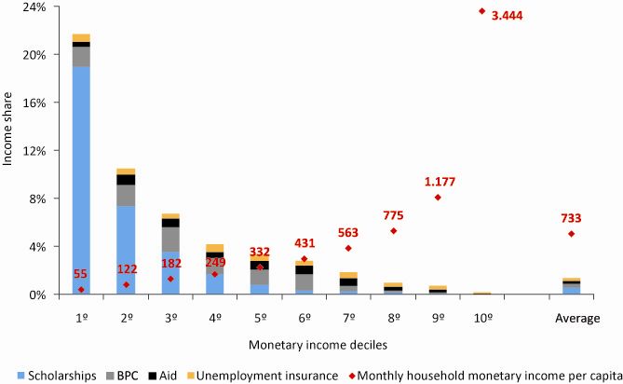
Share of Bolsa Família, Aid, Unemployment Insurance and BPC in Monetary Income, by Income Deciles, Brazil (2008–2009)

Slide 24
Income inequality
(Gini Index)
Stagnant inequality
∆ 2001-2009:
-9.2%
Source: Pesquisa Nacional por Amostra de Domicílios, 1995-2009
After decades of stagnant or rising inequality, the Gini index declined swiftly in the 2000s. Nevertheless, Brazilian income inequality is still considerably large: even if the current pace is maintained, it would take another couple of decades to reach the inequality levels presently found in developed countries.

Slide 25
Gini decomposition
(ii)
 | Concentration Coef | Income share | Contribution to Gini | % of Gini
 |  | 2001 | 2009 | 2001 | 2009 | 2001 | 2009 | 2001 | 2009
Labor | Minimum wage | -0.115 | -0.091 | 0.021 | 0.036 | -0.002 | -0.003 | -0.4 | -0.6
 | Other | 0.608 | 0.576 | 0.759 | 0.726 | 0.461 | 0.418 | 77.7 | 77.5
Pensions | Minimum wage | 0.097 | 0.157 | 0.037 | 0.057 | 0.004 | 0.009 | 0.6 | 1.7
 | Other | 0.743 | 0.742 | 0.134 | 0.131 | 0.099 | 0.097 | 16.7 | 18.0
Programa Bolsa Família & other CCTs |  | -0.315 | -0.526 | 0.001 | 0.007 | 0.000 | -0.004 | 0.0 | -0.7
BPC |  | -0.081 | -0.016 | 0.001 | 0.006 | 0.000 | 0.000 | 0.0 | 0.0
Other |  | 0.672 | 0.603 | 0.048 | 0.037 | 0.032 | 0.022 | 5.4 | 4.2
Gini |  |  |  | 1 | 1 | 0.594 | 0.539 | 100 | 100
Source: Pesquisa Nacional por Amostra de Domicílios, 2001 & 2009
Notes:
Todos os CC’s que eram regressivos diminuíram ou ficaram estável. Fontes mais progressivas ganharam %. Indexação ao SM é positiva, mas ficou menos no tempo (valorização maior do que crescimento da renda real). PBF excepcionalmente progressivo. BPC também o é, mas valor mais alto.

Slide 26
Gini decomposition
(iii)
Dynamic decomposition:
= Composition + Concentration
2001-2009 |  | Composition effect | Concentration effect | Total | As % of ∆Gini
Labor | Minimum wage | -0.010 | 0.001 | -0.010 | 17.9
 | Other | -0.001 | -0.024 | -0.025 | 45.5
Pensions | Minimum wage | -0.009 | 0.003 | -0.006 | 10.5
 | Other | 0.000 | 0.000 | -0.001 | 1.0
Programa Bolsa Família & other CCTs |  | -0.006 | -0.001 | -0.007 | 12.7
BPC |  | -0.003 | 0.000 | -0.003 | 5.7
Other |  | -0.001 | -0.003 | -0.004 | 6.7
Total |  | -0.031 | -0.024 | -0.055 | 100
46.8% of the ∆Gini
Source: Pesquisa Nacional por Amostra de Domicílios, 2001 & 2009

Slide 27
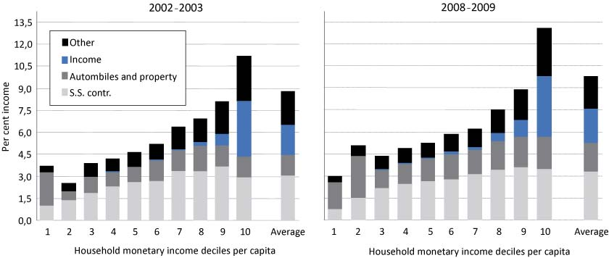
Behaviour of the Incidence of Direct Taxation on Income, by Type of Tax and Deciles of Monetary Household Income, Per Capita, Brazil (2002–2003 and 2008–2009)

Slide 28
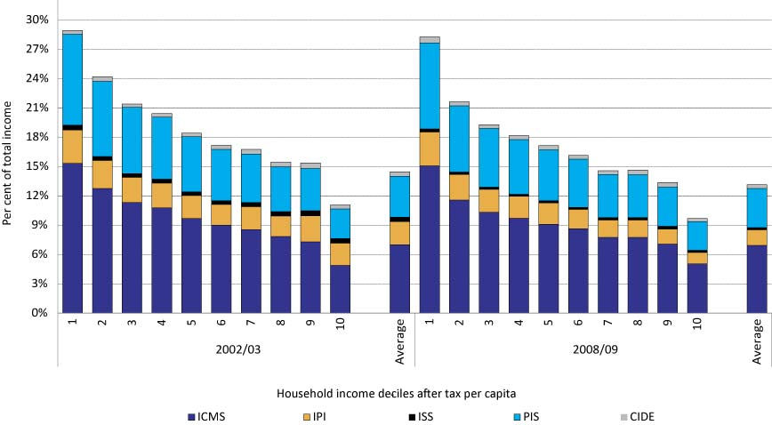
Behaviour of the Incidence of Indirect Taxes on Total Income, by Type of Tax and According to Per Capita Household Final Monetary Income Deciles (net of taxes),
Brazil (2002–2003 and 2008–2009)

Slide 29
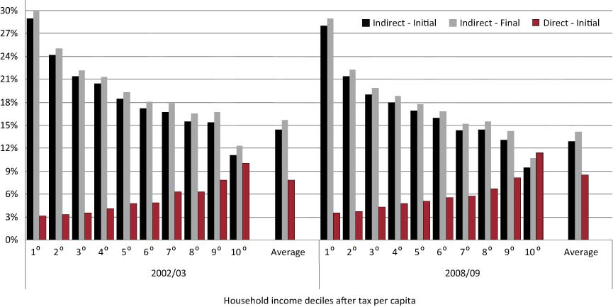
Tax Burden on Total Income, Brazil (2002–2003 and 2008–2009)

Slide 30
Education
(ii)
 | 1995 | 2009
Illiteracy rate: ages 15+ (%) | 15.5 | 9.7
Illiteracy rate: ages 15-24 (%) | 7.1 | 1.9
Attendance rate: ages 6-14 (%) | 88.7 | 97.6
Attendance rate: ages 15-17 (%) | 66.7 | 85.2
Economically active population | 1995 | 2009
Completed at least primary education (%) | 34.5 | 61.7
Completed at least secondary education (%) | 20.7 | 44.1
Completed tertiary education (%) | 5.6 | 10.2
Source: Pesquisa Nacional por Amostra de Domicílios, 1995-2009

Slide 31
Education
(iii)
Mean years of schooling among the economically active population increased from 5.8 in 1995 to 8.3 in 2009 (+42%).
However, educational attainment is still quite low, as 8 years of schooling is just enough to complete the mandatory primary education.
The Gini index of the years of schooling among the economically active population plummeted from 0.413 in 1995 to 0.288 in 2009 (-30%).
This was one the key driving forces behind the rapid fall of labor market inequality.
Source: Pesquisa Nacional por Amostra de Domicílios, 1995-2009
Notes:
-Grade repetition

Slide 32
Trends in the distribution of the Public Education Expenditures by deciles, 2003 to 2007.

Slide 33
Distribution of the Public Health Expenditures by types of services or products and deciles – 2008.
Source: POF-IBGE (Consumer Expenditure Survey)

Slide 34
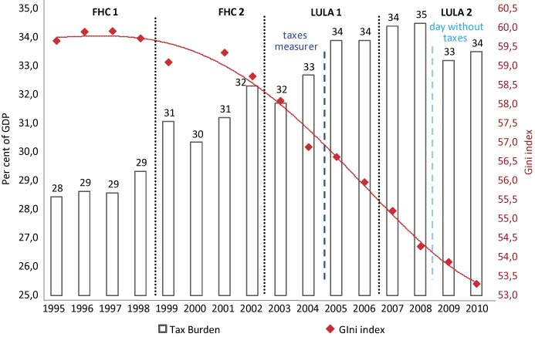
Evolution of the Tax Burden (percentage of GDP) and Gini Coefficient of Household Income Per Capita

Slide 35
GE(0) Decomposition
(ii)
LABOR INCOME | Absolute | Relative
All employed with earnings | 2002 | 2009 | Δ (%) | 2002 | 2009 | Δ (pp)
GE(0) | 0.582 | 0.491 | -16 | 100 | 100 | -
Between-group components
State + Schooling + Industry | 0.275 | 0.211 | -23 | 47.2 | 43.1 | -4.1
Schooling (16 groups) | 0.209 | 0.158 | -24 | 35.9 | 32.2 | -3.9
Industry (8) | 0.085 | 0.072 | -15 | 14.6 | 14.8 | +0.2
Race (5) | 0.057 | 0.039 | -33 | 9.9 | 7.9 | -2.0
State (27) | 0.050 | 0.032 | -36 | 8.6 | 6.6 | -2.0
Urban/rural areas | 0.033 | 0.019 | -43 | 5.6 | 3.8 | -1.8
Male/female | 0.014 | 0.013 | -5 | 2.4 | 2.7 | +0.3
Source: Pesquisa Nacional por Amostra de Domicílios, 2002 & 2009

Slide 36
GE(0) Decomposition
(iii)
LABOR INCOME | Δ2002-2009 | %
Pure inequality effect | -0.041 | 45.3
Allocation effect | 0.013 | -14.9
Income effect | -0.062 | 69.2
Total | -0.091 | 100
Source: Pesquisa Nacional por Amostra de Domicílios, 2002 & 2009
Educational improvement entailed a negative allocation effect, but a more homogeneously educated labor force sustained a dominant income effect as declining returns to education narrowed the income gaps among the different levels of educational attainment. Within-group inequality also contributed tremendously to the overall drop of the GE(0) index.

Slide 37
Conclusions
Poverty and inequality reduction was made possible by more effective social policies and a consumer-led economic boom. As Brazil is still a middle-income country with an unacceptably high level of income inequality, the recent trajectory of pro-poor growth must be preserved at all costs.
There has been a renewed commitment to social programs since the 1988 Constitution and they now comprise a hefty 16% of the GDP and represent extremely valuable tools to reduce poverty and inequality. Educational policies and minimum wage hikes have had a great impact on the labour market while Social Security and Social Assistance expenditures have greatly diminished poverty among the elderly and, to a lesser extent, children.
There is still plenty of room for improvement:
Bolsa Família is formidable, but the benefits are still too low and there are eligible families that are not in the program.
Civil servants' social security is inordinately expensive and runs huge annual deficits.
Educational attainment is still too low and the overall quality of public schools is substandard.
Some policies that could do a lot to reduce poverty and inequality have been pretty much set aside (ie: land reform).

